Slide 1

Offline Handwritten Character Recognition using Few-Shot Learning
Thesis ID- T2310060
Submitted by-
Priya Saha 22241185
Supervised by
Annajiat Alim Rasel
Senior Lecturer,
Dept of Computer Science and Engineering,
BRAC University

Slide 2
Introduction
Converts handwritten or printed text into digital data
Important for digital accessibility in translation, all sort of document management
Optical Character Recognition
Complex and recursive shape
Compound characters
Bangla Character Recognition

Slide 3
Research Problem
Lack of prior work on Bangla Optical character recognition with limited datasets
Difficult to train model with limited data
Achieve recognition with minimal training samples

Slide 4
It’s a cutting-edge deep learning approach
It is designed to learn from very few labelled examples more like humans
This technique is ideal approach for image classification with scarce datasets in any domains
What is Few-shot Learning?

Slide 5
Research Objective
Making a new research path for low resource language datasets which have complex characteristics like Bangla
Apply few shot learning with prototypical networks to Bangla character recognition for the first time
To experiment with how the prototypical network fits with image classification models like ResNet50, VGG16, MobileNet, DenseNet121, InceptionV3

Slide 6
Literature Review(1)
Shape decomposition-based handwritten compound character recognition for Bangla OCR
Breaks down compound characters into distinct shape components
Segmentation focus
Achieved higher accuracy with fewer classes
Limitations
Struggle with highly complex or irregular compound characters where is segmentation is unclear

Slide 7
Literature Review(2)
Bangla Handwritten Character Recognition Using Extended Convolutional Neural Network
CNN architecture
Evaluated on the BanglaLekha-Isolated dataset with 39 consonant classes and 11 vowel classes.
Limitations
Lower accuracy for consonants

Slide 8
Literature Review(3)
A machine learning approach for Bengali handwritten vowel character recognition
Used face mapping and basic machine learning with Scikit-Learn and SVM classifier
Mainly focused on 11 vowel characters
Limitations
Model doesn’t scale well with their datasets

Slide 9
Literature Review(4)
Prototypical networks for few-shot learning
Omniglot Dataset: 98.8% accuracy for 1-shot 5-way, 99.7% for 5-shot 5-way classification
miniImageNet Dataset: 49.42% accuracy for 1-shot 5-way, 68.20% for 5-shot 5-way classification
Limitations
Lower performance on complex datasets like miniImageNet

Slide 10
Literature Review(5)
An enhanced prototypical network architecture for few-shot handwritten urdu character recognition
to recognize Urdu handwritten characters with small dataset using Euclidean embeddings and class prototypes for classification
Prototypical network effective for minimal data
Limitations
Limited data hampers model training
Euclidean distance cannot handle all character variations

Slide 11
Literature Review(6)
Few-Shot Learning for Tamil Handwritten Character Recognition Using Deep Siamese Convolutional Neural Network
Used twin CNN architecture for feature extraction in few shot learning
Achieved 83.39% accuracy in 40 shot scenario
Limitations
Moderate accuracy

Slide 12
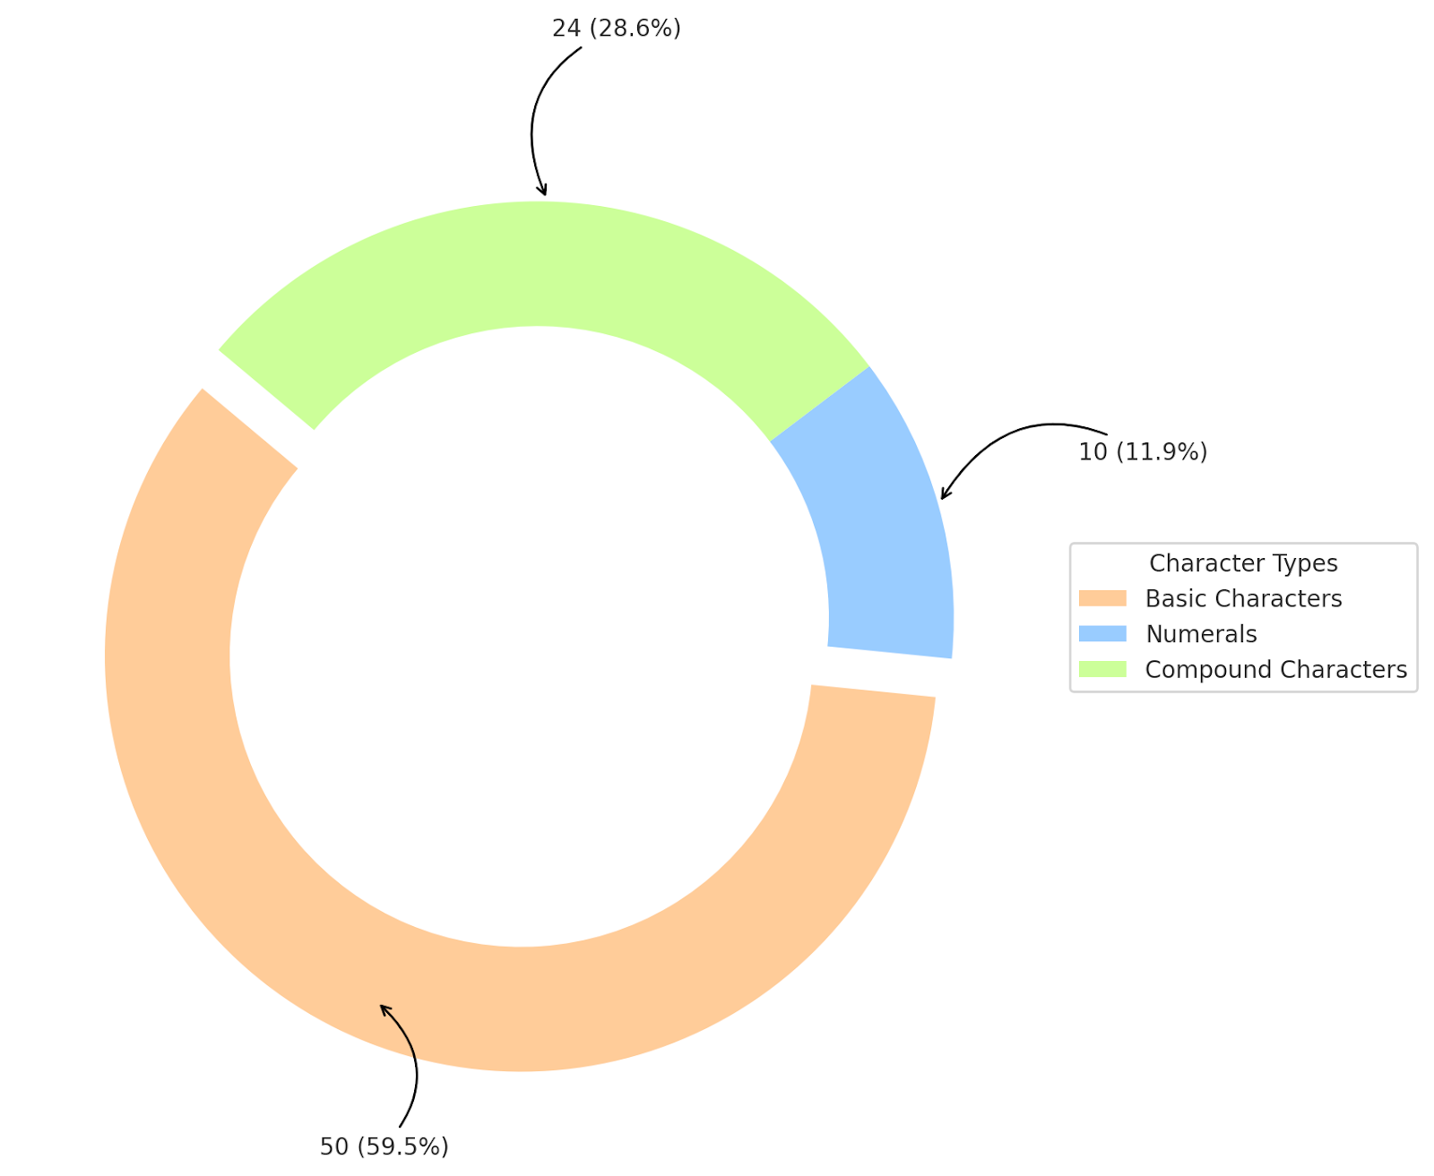
Dataset Description
Original Dataset
For my thesis project, I utilized the BanglaLekha-Isolated image dataset, This dataset contains 84 distinct characters, including 50 basic Bangla characters, 10 Bangla numerals, and 24 selected compound characters.

Slide 13
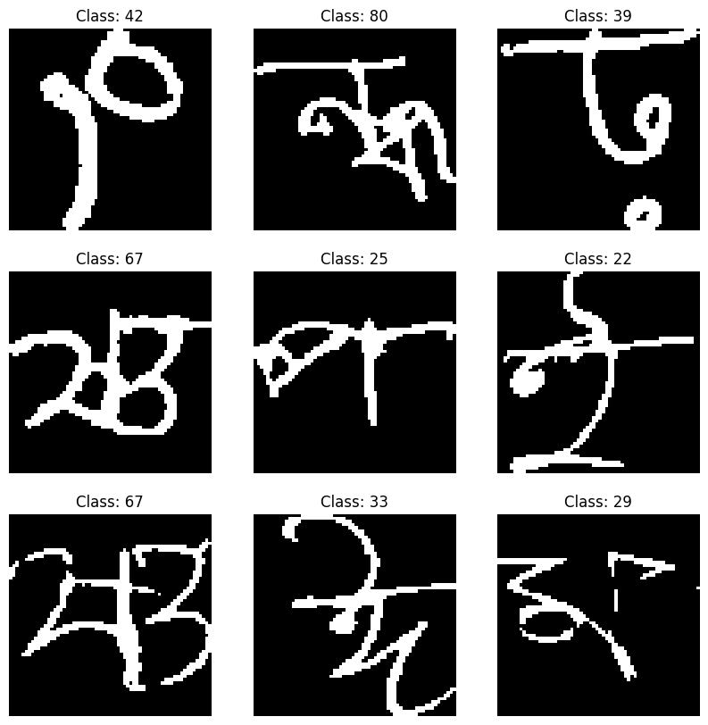
Dataset Description
Custom Dataset
reduced its size to make it suitable for few-shot learning. I selected 50 basic Bangla characters, 10 Bangla numerals, and 12 compound characters, totaling 72 characters. For each character, I chose 20 image samples.

Slide 14
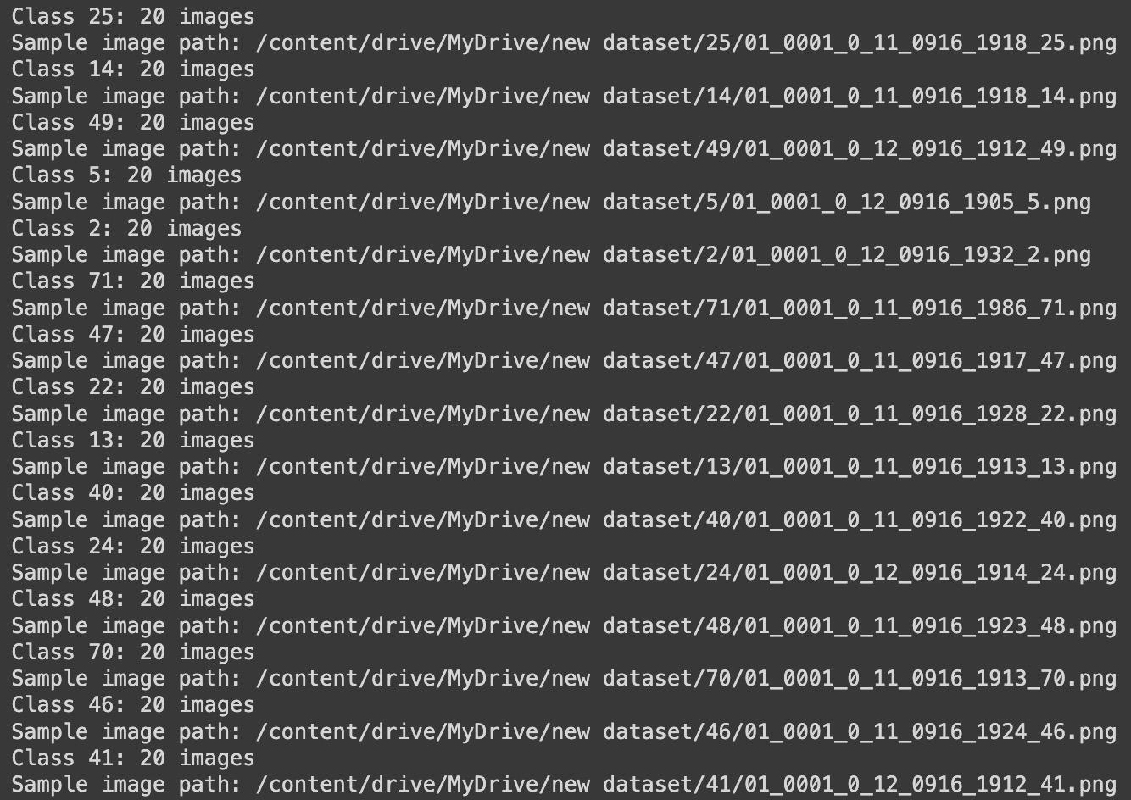
Data Preprocessing
Images resized to 224x224 pixels
Normalize Pixel Values to [0, 1]
Each character class stored in separate folders
images converted to numerical arrays and assigned labels.
80% of data used for training, 20% for testing

Slide 15
Few Shot Learning Setup with Prototypical Network
Each class has 20 images
Set 5 images for support set and 15 for query set
Class prototypes computed as the mean embeddings of support set images
Classification performed by calculating the distance between query image embeddings and class prototypes.

Slide 16
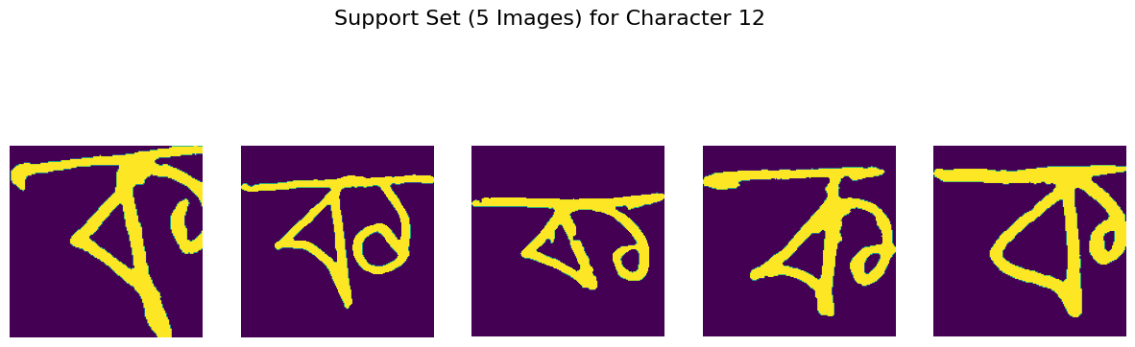
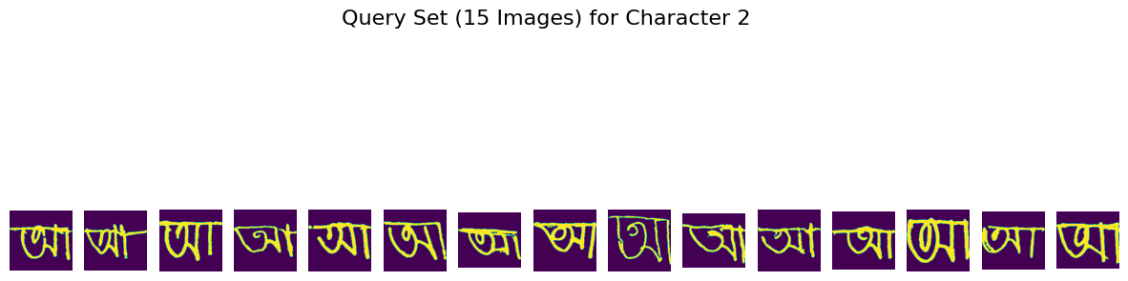
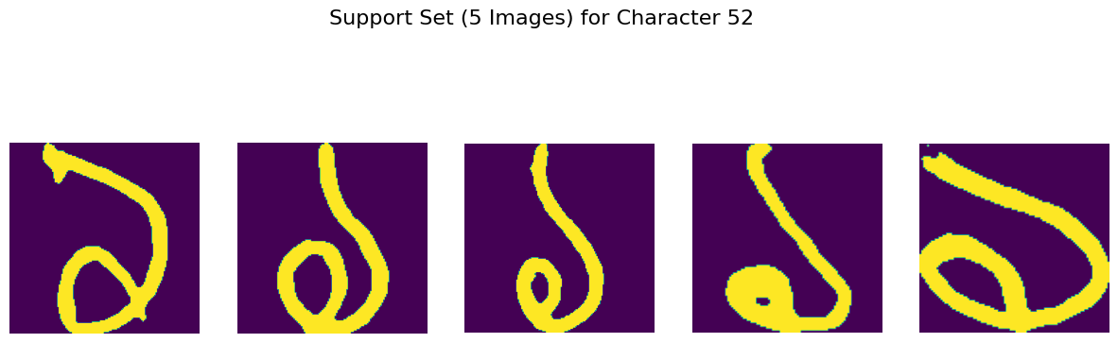
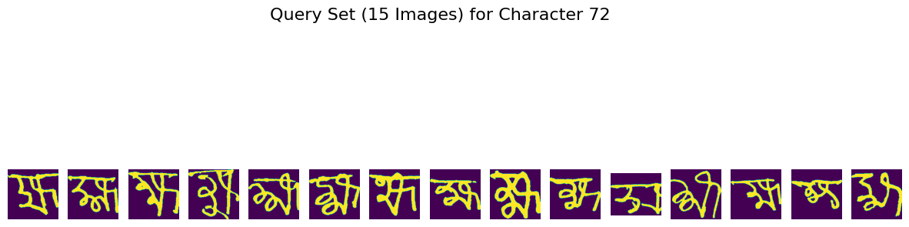

Slide 17
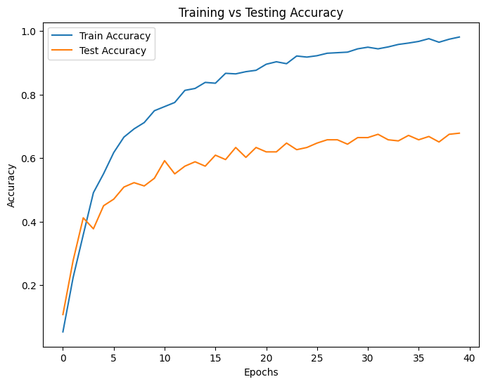
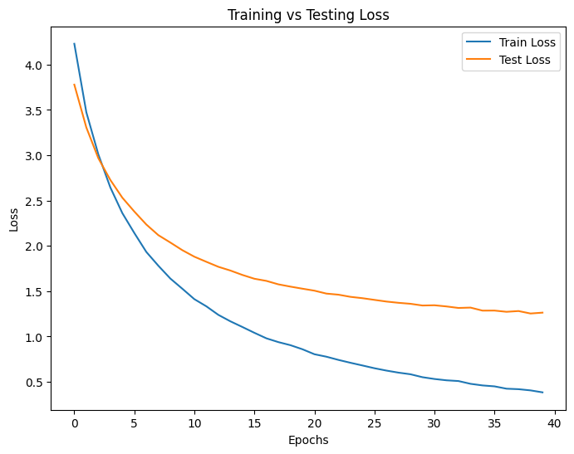
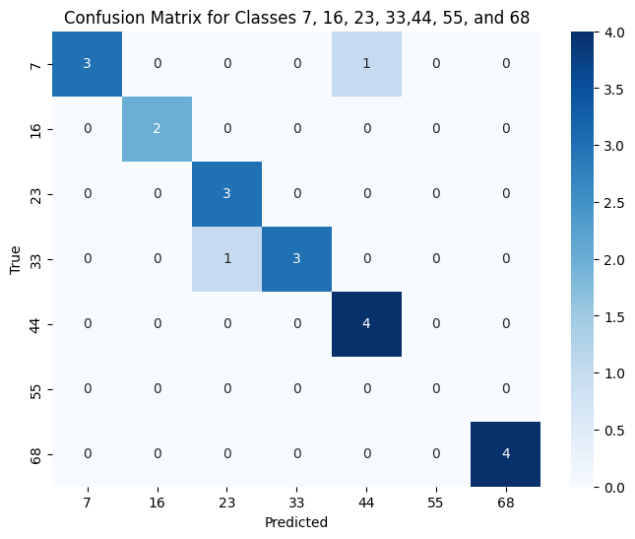
ResNet50
A deep convolutional neural network with 50 layers
used as the backbone for feature extraction in the few-shot learning setup
Accuracy 80%

Slide 18
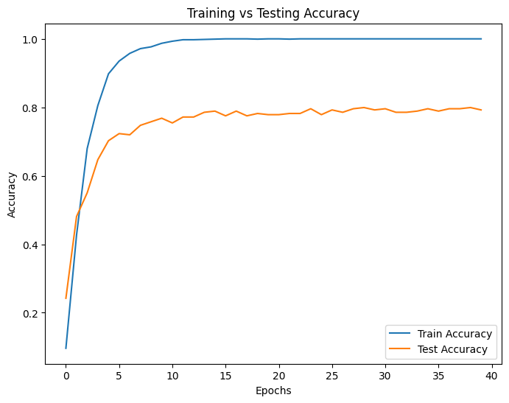
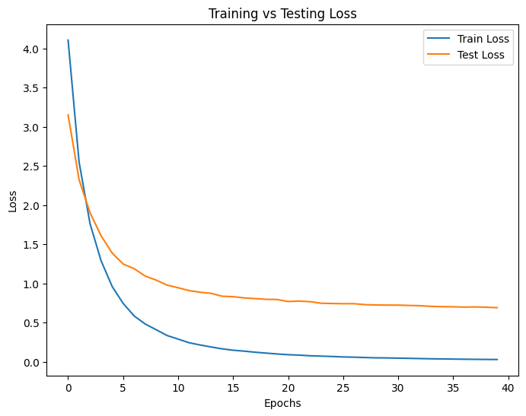
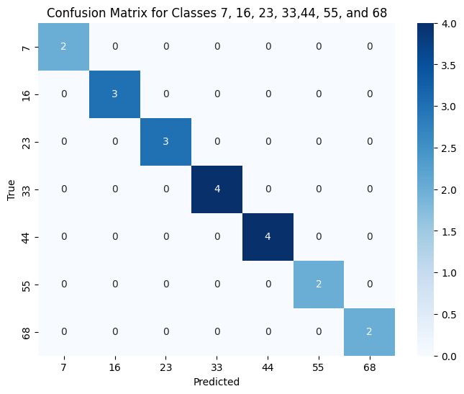
MobileNet
A lightweight convolutional neural network
224*224 image resolution
accuracy of 79%

Slide 19
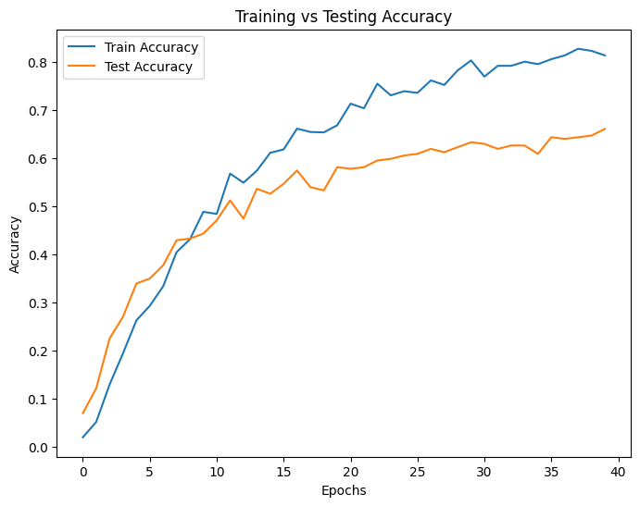
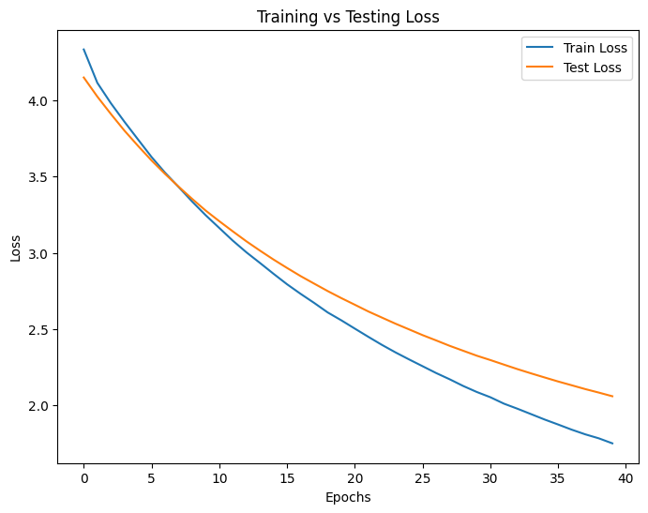
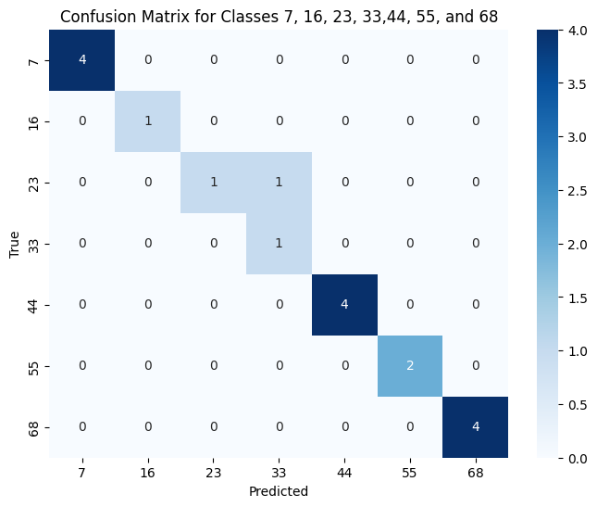
InceptionV3
Image classified model
Employ multiple parallel convolutional layers
Accuracy 66%

Slide 20
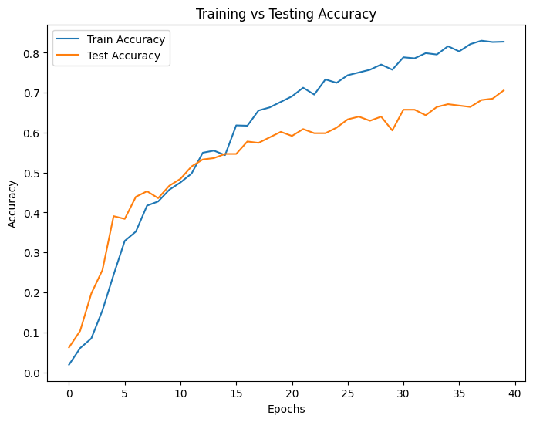
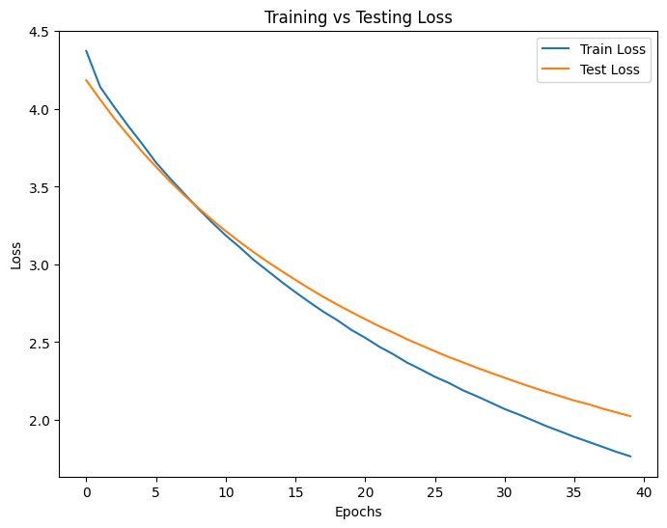
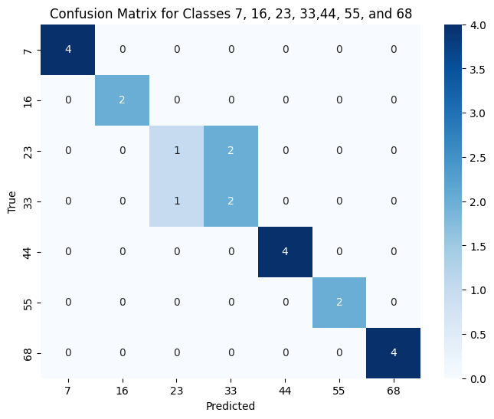
DenseNet121
Utilizes densely connected layers to improve information flow
Efficient in reusing features across layers
Accuracy 71%

Slide 21
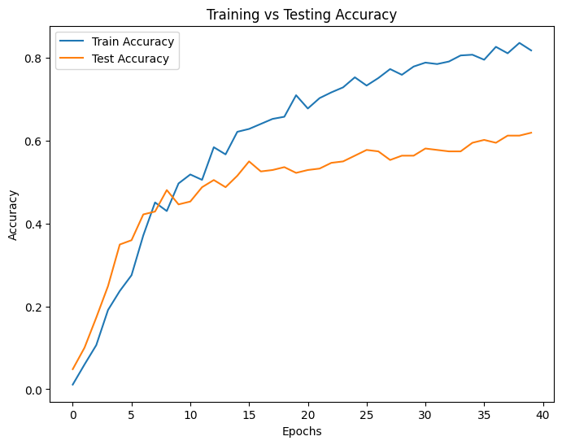

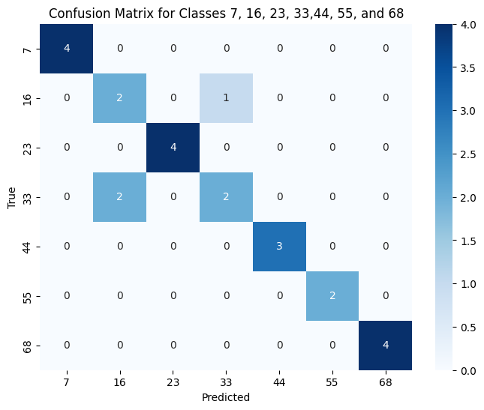
VGG16
16-layer convolutional neural network
Simple architecture
Accuracy 62%

Slide 22
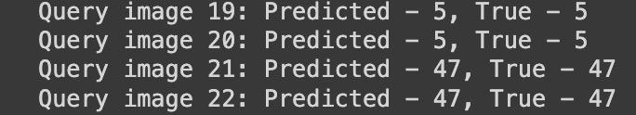
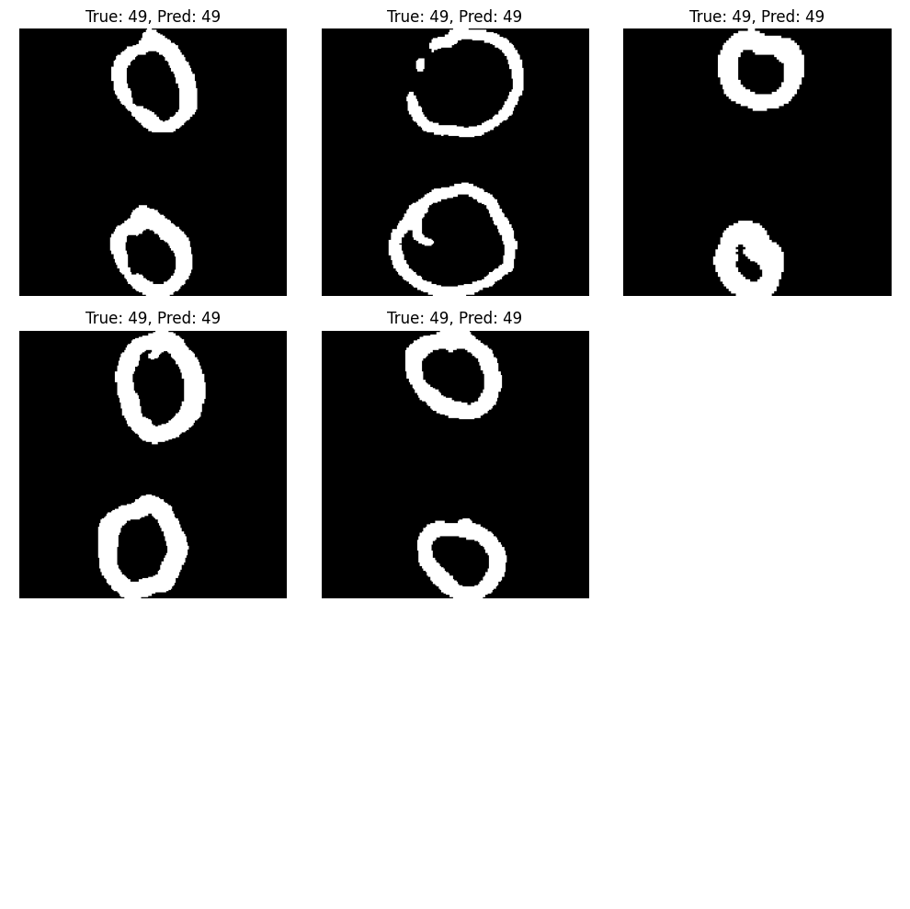
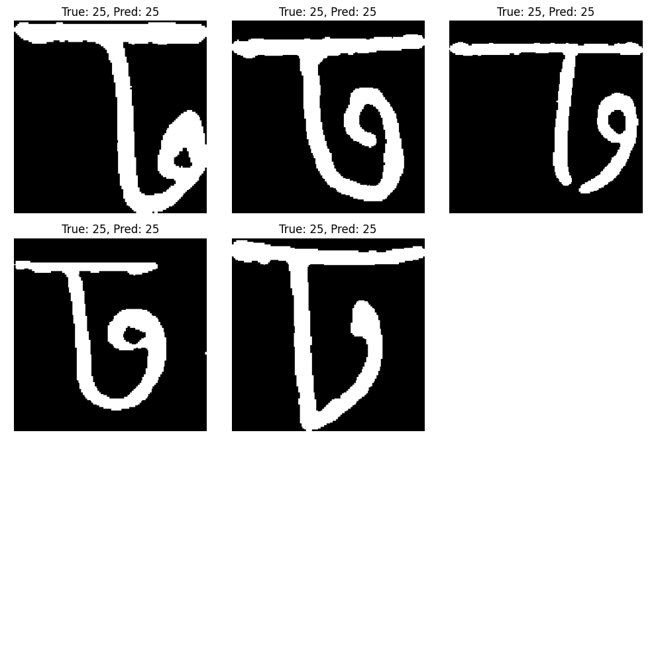
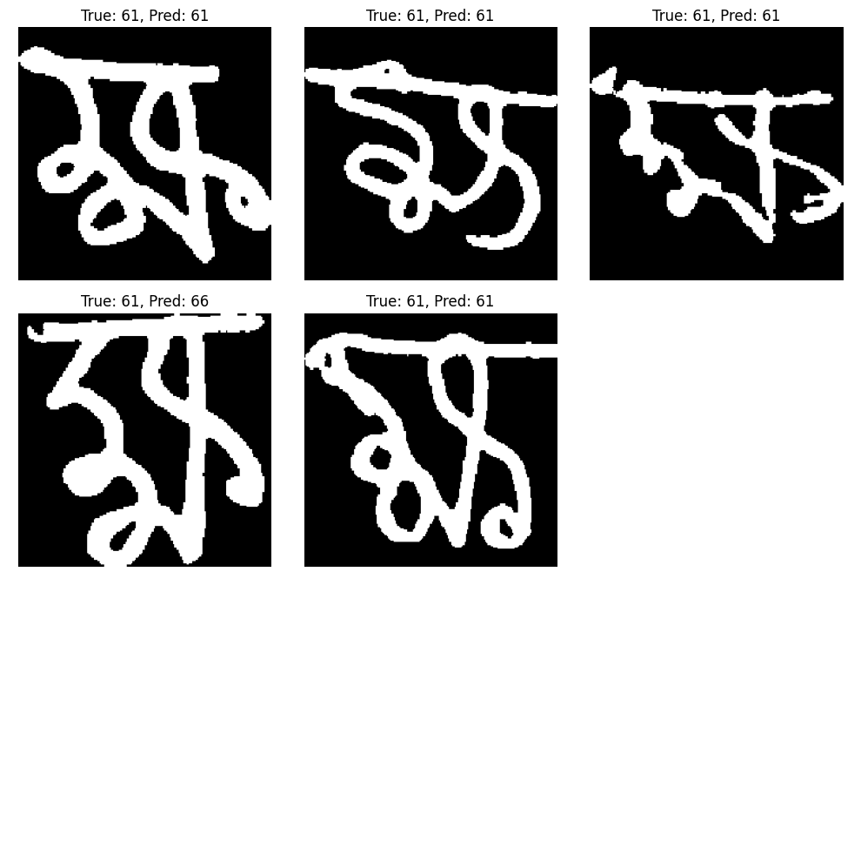
Character Prediction from Query Set

Slide 23
Performance Metrics Table
Model | Precision(%) | Recall(%) | F1 Score(%) | Accuracy(%)
ResNet50 | 70 | 68 | 66 | 68
VGG16 | 62 | 62 | 59 | 62
MobileNet | 82 | 79 | 79 | 79
InceptionV3 | 69 | 66 | 64 | 66
DenseNet121 | 72 | 70 | 70 | 71

Slide 24
Limitations
Lack of available datasets for few shot learning setup
Model did not perform well on unseen examples
Lack of resources customize Bangla language for this few shot learning setup
Time constraint

Slide 25
Conclusion
Creating a new research path for Bangla character recognition
This research highlights on the potentiality of few-shot learning technique
Low resource tribal languages will get benefits that ensures their digital footprints like other popular languages

Slide 26
Thank You

Slide 27
References
[2] J. Snell, K. Swersky, and R. Zemel, “Prototypical networks for few-shot learning,” in Advances in Neural Information Processing Systems, I. Guyon, U. V. Luxburg, S. Bengio, et al., Eds., vol. 30, Curran Associates, Inc., 2017. [Online]. Available: https://proceedings.neurips.cc/paper files/paper/2017/file/ cb8da6767461f2812ae4290eac7cbc42-Paper.pdf.
[4] R. Pramanik and S. Bag, “Shape decomposition-based handwritten compound character recognition for bangla ocr,” Journal of Visual Communication and Image Representation, vol. 50, pp. 123–134, 2018.
[14] T. R. Das, S. Hasan, M. R. Jani, F. Tabassum, and M. I. Islam, “Bangla handwritten character recognition using extended convolutional neural network,” Journal of Computer and Communications, vol. 9, no. 03, pp. 158–171, 2021.

Slide 28
References
[16] S. Ahsan, T. N. Shah, T. B. Sarwar, M. S. U. Miah, and A. Bhowmik, “A machine learning approach for bengali handwritten vowel character recognition,” IAES International Journal of Artificial Intelligence, vol. 11, no. 3, p. 1143, 2022.
[19] R. Sahay and M. Coustaty, “An enhanced prototypical network architecture for few-shot handwritten urdu character recognition,” IEEE Access, vol. 11, pp. 33 682–33 696, 2023.
[16] Shaffi, N., Hajamohideen, F. (2021). Few-Shot Learning for Tamil Handwritten Character Recognition Using Deep Siamese Convolutional Neural Network. In: Mahmud, M., Kaiser, M.S., Kasabov, N., Iftekharuddin, K., Zhong, N. (eds) Applied Intelligence and Informatics. AII 2021. Communications in Computer and Information Science, vol 1435. Springer, Cham. https://doi.org/10.1007/978-3-030-82269-9_16

